Slide 1

Modern Career Guidance
A Personalized Approach to Success
Under The Guidance of Dr S M Roy Choudri
Professor & HOD OF CSE
Team Members Kanchana Sesha Siana Sai Kumar – 21NG1A0521
Seelam Tejaswi – 21NG1A0554
Chavala Venkat Kalyan – 21NG1A0509
Dasari Sudheer Babu – 22NG5A0504

Slide 2
TABLE OF CONTENTS
1. Abstract
2. Literature Survey
3. Motivation
4. Problem statement/
Identification.
5. Operation Feasibility
6. Technical Feasibility
7. Use Case Diagram
8. Class Diagram
9. Sequence Diagram
10. Activity Diagram
11. Component Diagram
12. Key Milestones
13. Conclusion

Slide 3

ABSTRACT
Modern Career Guidance platform: A tool for personalized career development.
Provides data-driven insights to empower individuals and professionals.
Key features include:
Skill Gap Analysis & Personalized Learning Plans
Course Recommendations
Job Matching
Feedback System
Leverages cutting-edge technologies to address career growth needs.
Aligns user skills with industry trends for better career opportunities.
Helps users navigate the dynamic and competitive job market effectively.

Slide 4
LITERATURE SURVEY
Base Papers | Algorithms | Observation | Limitations
Career Guidance and Employment Management System | K-Nearest Neighbors (KNN), Collaborative Filtering or Content-Based Filtering, Bayesian Networks, TF-IDF (Term Frequency-Inverse Document Frequency) or Latent Semantic Analysis (LSA) | It integrates career tests, job postings, and expert consultation services, addressing challenges in career clarity and hiring processes. | lack of integration seen in existing platforms, which provide generic career advice without real-time updates or personalized guidance. Additionally, many current systems have non-user-friendly interfaces,
Career guidance and its impact on graduate employability | Collaborative Filtering Algorithms, Decision Trees, K-Means Clustering, Natural Language Processing (NLP) Algorithms, Bayesian Networks, Regression Analysis, AHP (Analytic Hierarchy Process) | It tells more personalized and proactive approaches to career guidance, to help students better understand their own skills, interests, and the dynamic career landscape. | ineffectiveness of school-based career counseling, late introduction of career guidance, as students often do not receive adequate guidance, mismatch between the information provided through counseling and the actual demands of the job market, leading to a gap in employability skills.
Conclusion: many career guidance platforms are available, they often fall short in providing personalized advice tailored to individual skills and interests. Additionally, these platforms typically lack real-time feedback and dynamic updates, which limits their ability to keep students informed about changing career trends and the evolving job market. More personalized and up-to-date guidance tools are necessary for effective career planning.

Slide 5

MOTIVATION
The rapidly evolving job market demands continuous skill development and adaptability.
Many individuals struggle with identifying skill gaps and aligning their capabilities with industry demands.
Existing career guidance systems often lack personalization and fail to provide actionable insights.
There is a growing need for a data-driven approach to career development that integrates modern technologies.
Empowering individuals to make informed career decisions can help them:
Stay competitive in their chosen fields.
Seamlessly transition to new career paths as industries evolve.
Achieve professional growth through targeted skill enhancement and opportunities.
Organizations and institutions can also benefit from improved talent development and workforce alignment.
This project addresses these needs by offering a customized, tech-enabled solution for career guidance and planning.

Slide 6
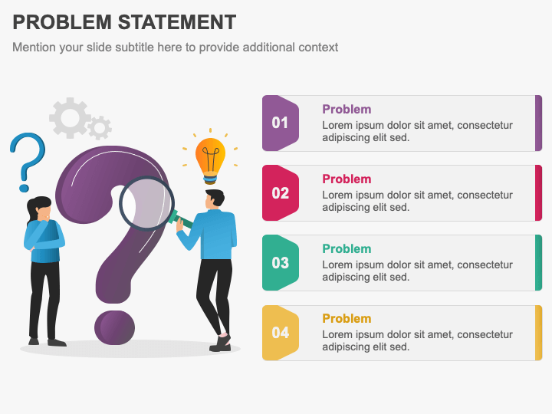
PROBLEM STATEMENT
The current career guidance landscape lacks a personalized and data-driven approach to help individuals navigate their professional growth effectively.
Many users face challenges in:
Identifying skill gaps and aligning their skills with evolving industry trends.
Finding suitable courses, certifications, or learning paths tailored to their career goals.
Matching their unique profiles with relevant job opportunities that align with their long-term aspirations.
Receiving actionable feedback to improve their skill sets and remain competitive in the dynamic job market.
This project aims to develop a Modern Career Guidance platform to bridge these gaps by offering tailored career insights, leveraging advanced technologies, and empowering users to take control of their professional journeys.

Slide 7
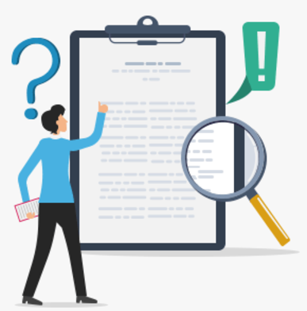
PROBLEM IDENTIFICATION
Lack of Personalization: Career guidance solutions often provide generic advice rather than insights tailored to individual needs, skills, and goals.
Disconnected Resources: Current systems fail to integrate skill gap analysis, job matching, and course recommendations into a cohesive and seamless platform.
Industry Misalignment: Users struggle to stay aligned with rapidly changing industry demands due to insufficient and outdated career guidance.
Ineffective Feedback Systems: Limited mechanisms exist for users to assess and improve their progress through feedback from learning modules or job applications.
By addressing these issues, the project seeks to empower individuals with a comprehensive and effective platform for career advancement.

Slide 8
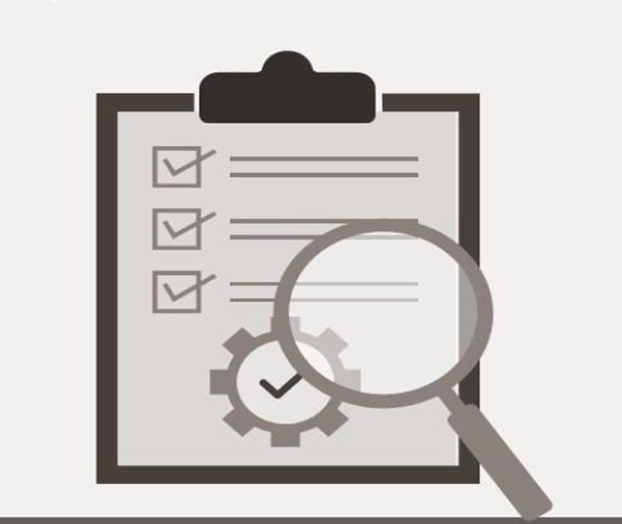
OPERATIONAL FEASIBILITY
User-Friendly Design: The platform provides a simple and intuitive user interface. It offers a seamless experience by integrating skill gap analysis, course recommendations, and job matching into one system.
Personalization: The system dynamically generates personalized career insights and recommendations tailored to users' unique skills, preferences, and goals.
Support for Multiple Stakeholders: For Individuals: Helps users achieve career growth and find opportunities that match their aspirations. For Institutions: Assists educational organizations and businesses in developing talent pipelines by aligning users with relevant courses and skills.
Maintenance and Upgrades: Regular updates to incorporate industry trend changes and keep recommendations current. Feedback from users ensures continuous improvement of the system's features and usability.

Slide 9
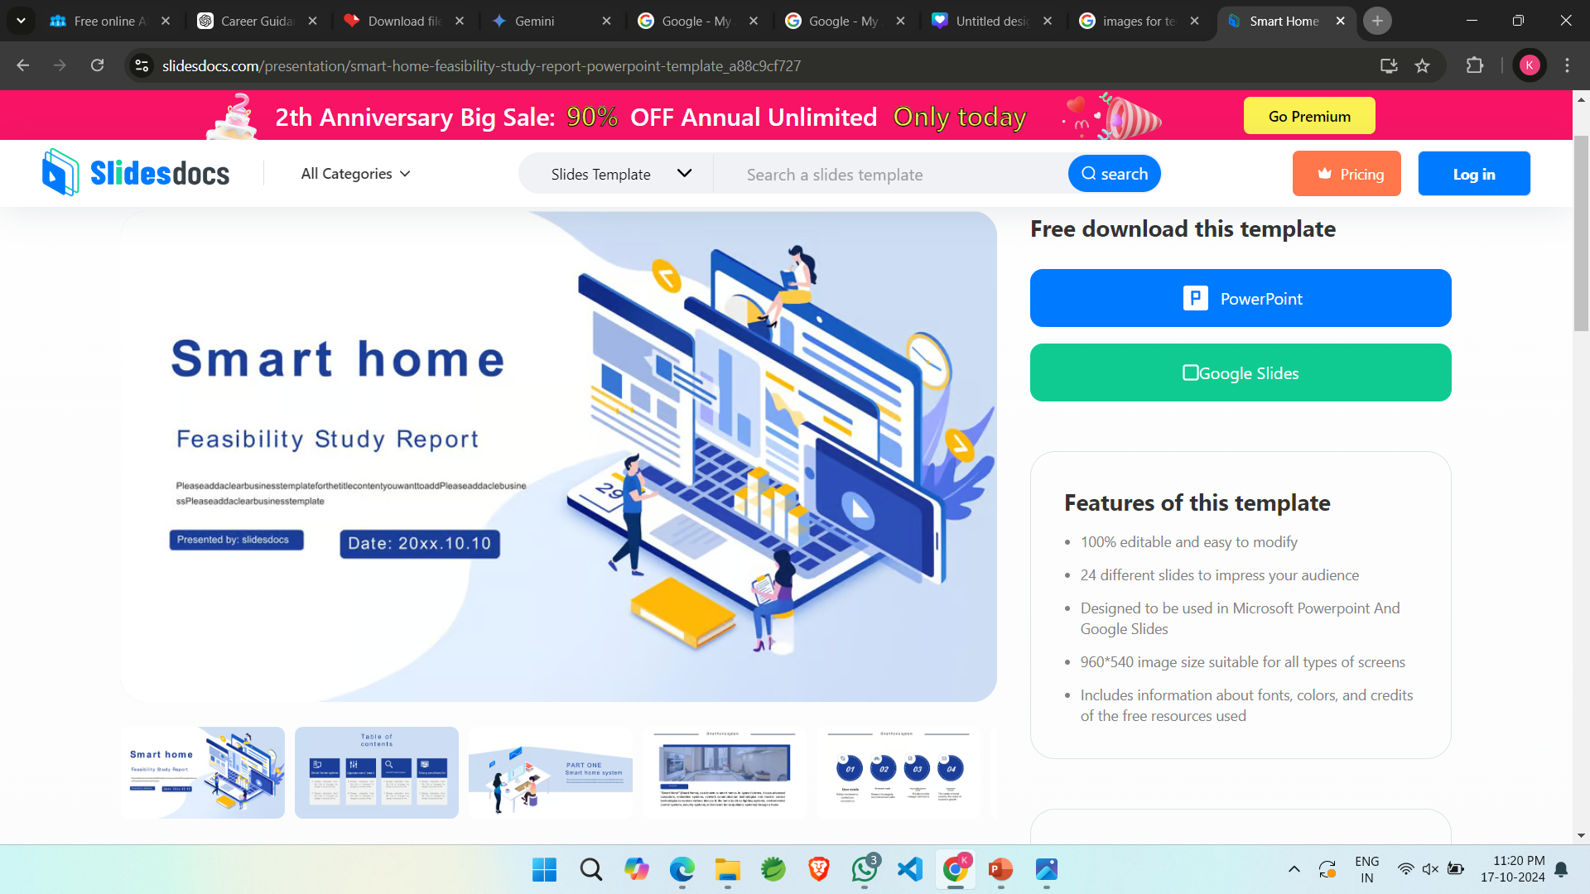
TECHNICAL FEASIBILITY
Front End:
HTML
CSS
JAVASCRIPT
Back End:
JAVA
MY SQL DATABASE
SPRING BOOT

Slide 10
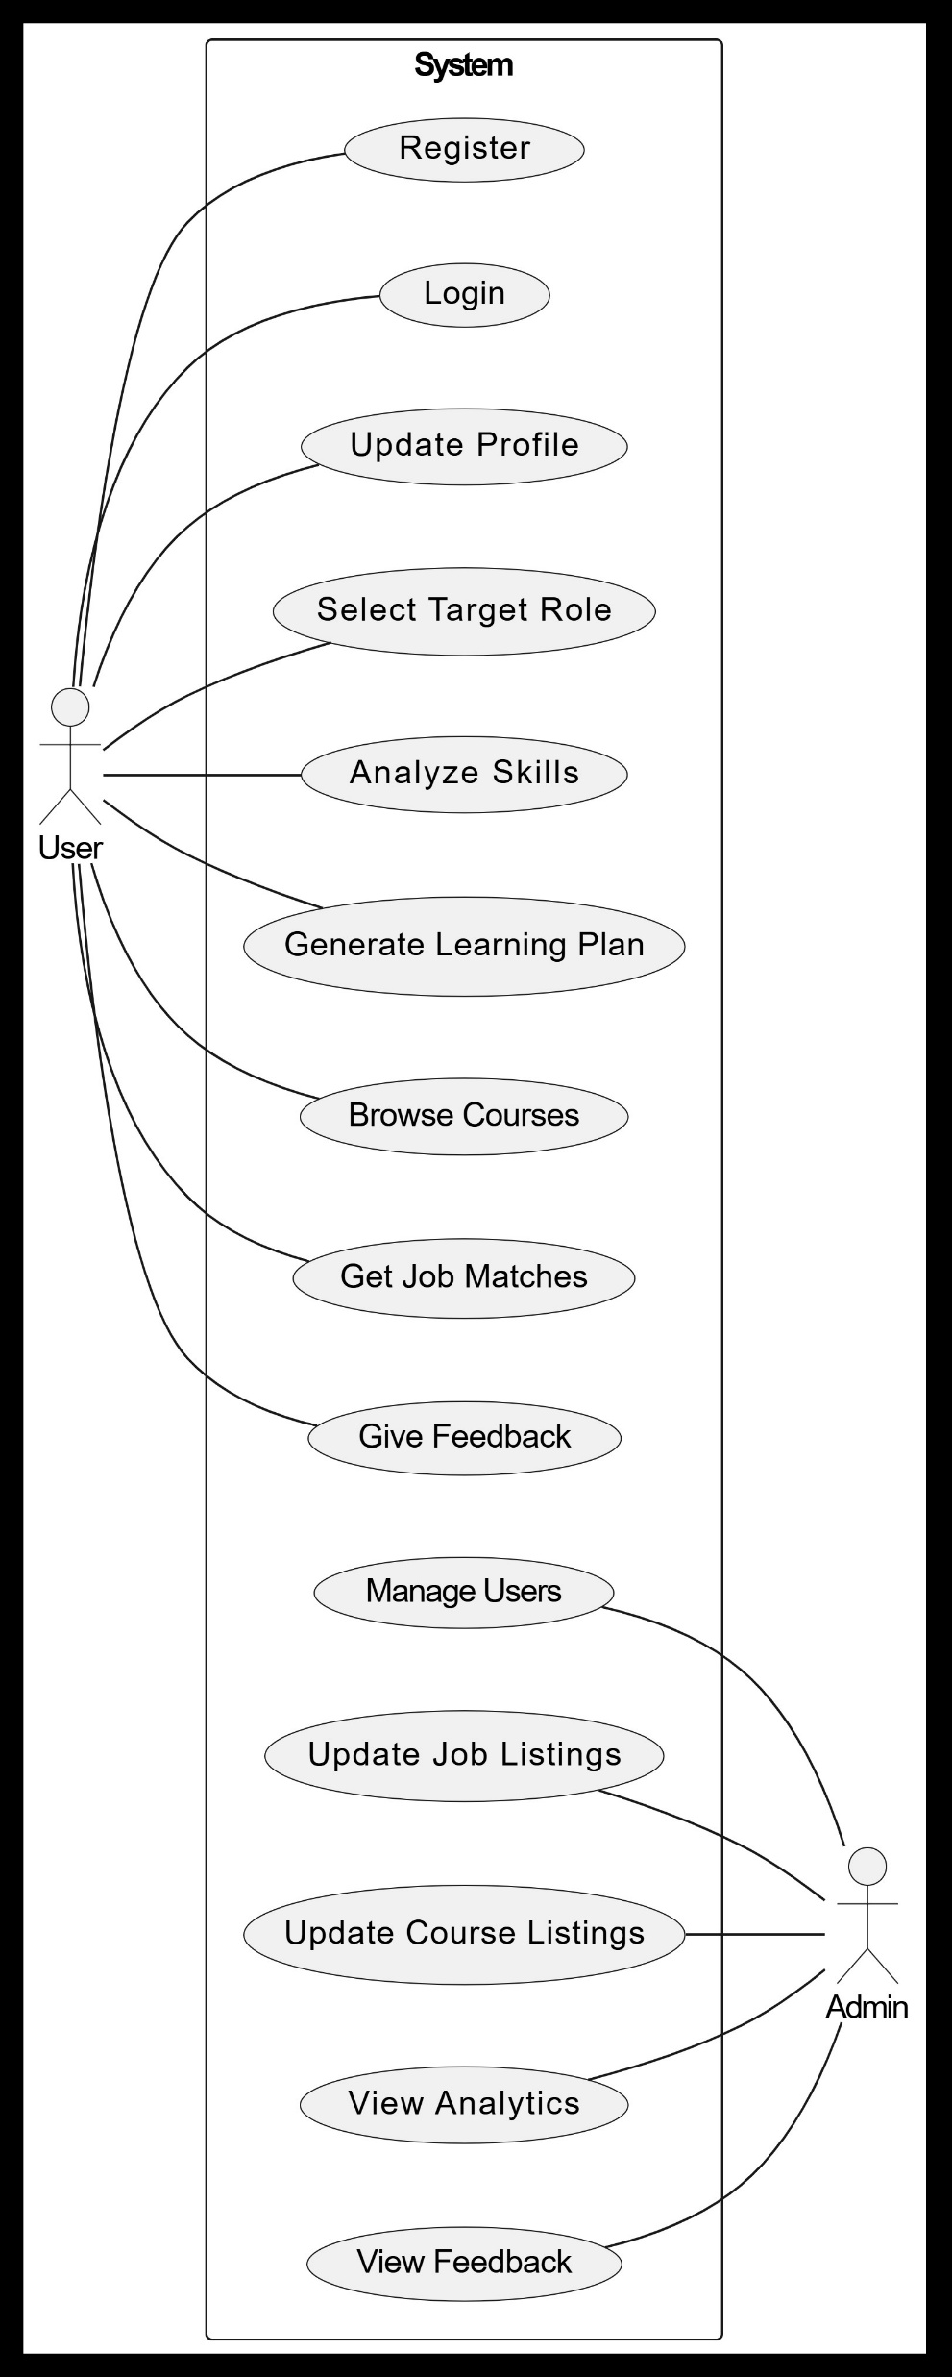
USE CASE DIAGRAM

Slide 11
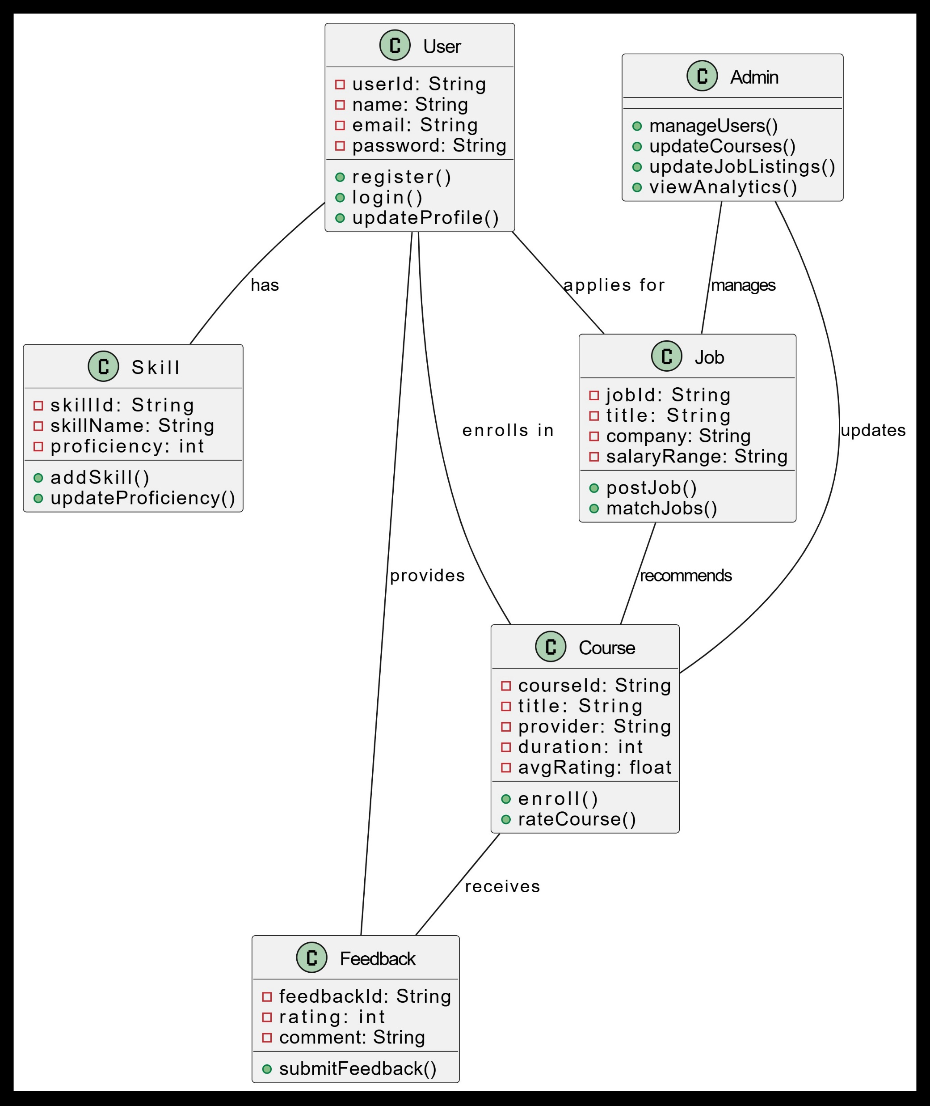
CLASS DIAGRAM

Slide 12
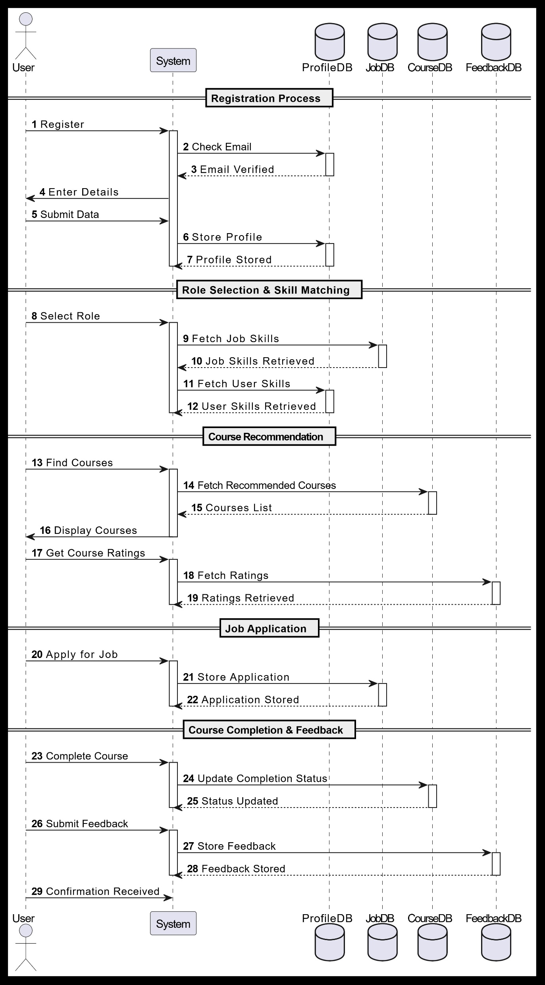
SEQUENCE DIAGRAM

Slide 13
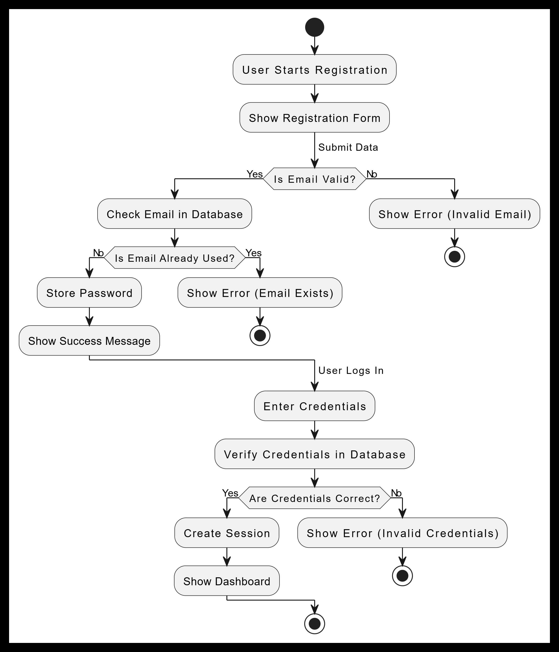
ACTIVITY DIAGRAM

Slide 14
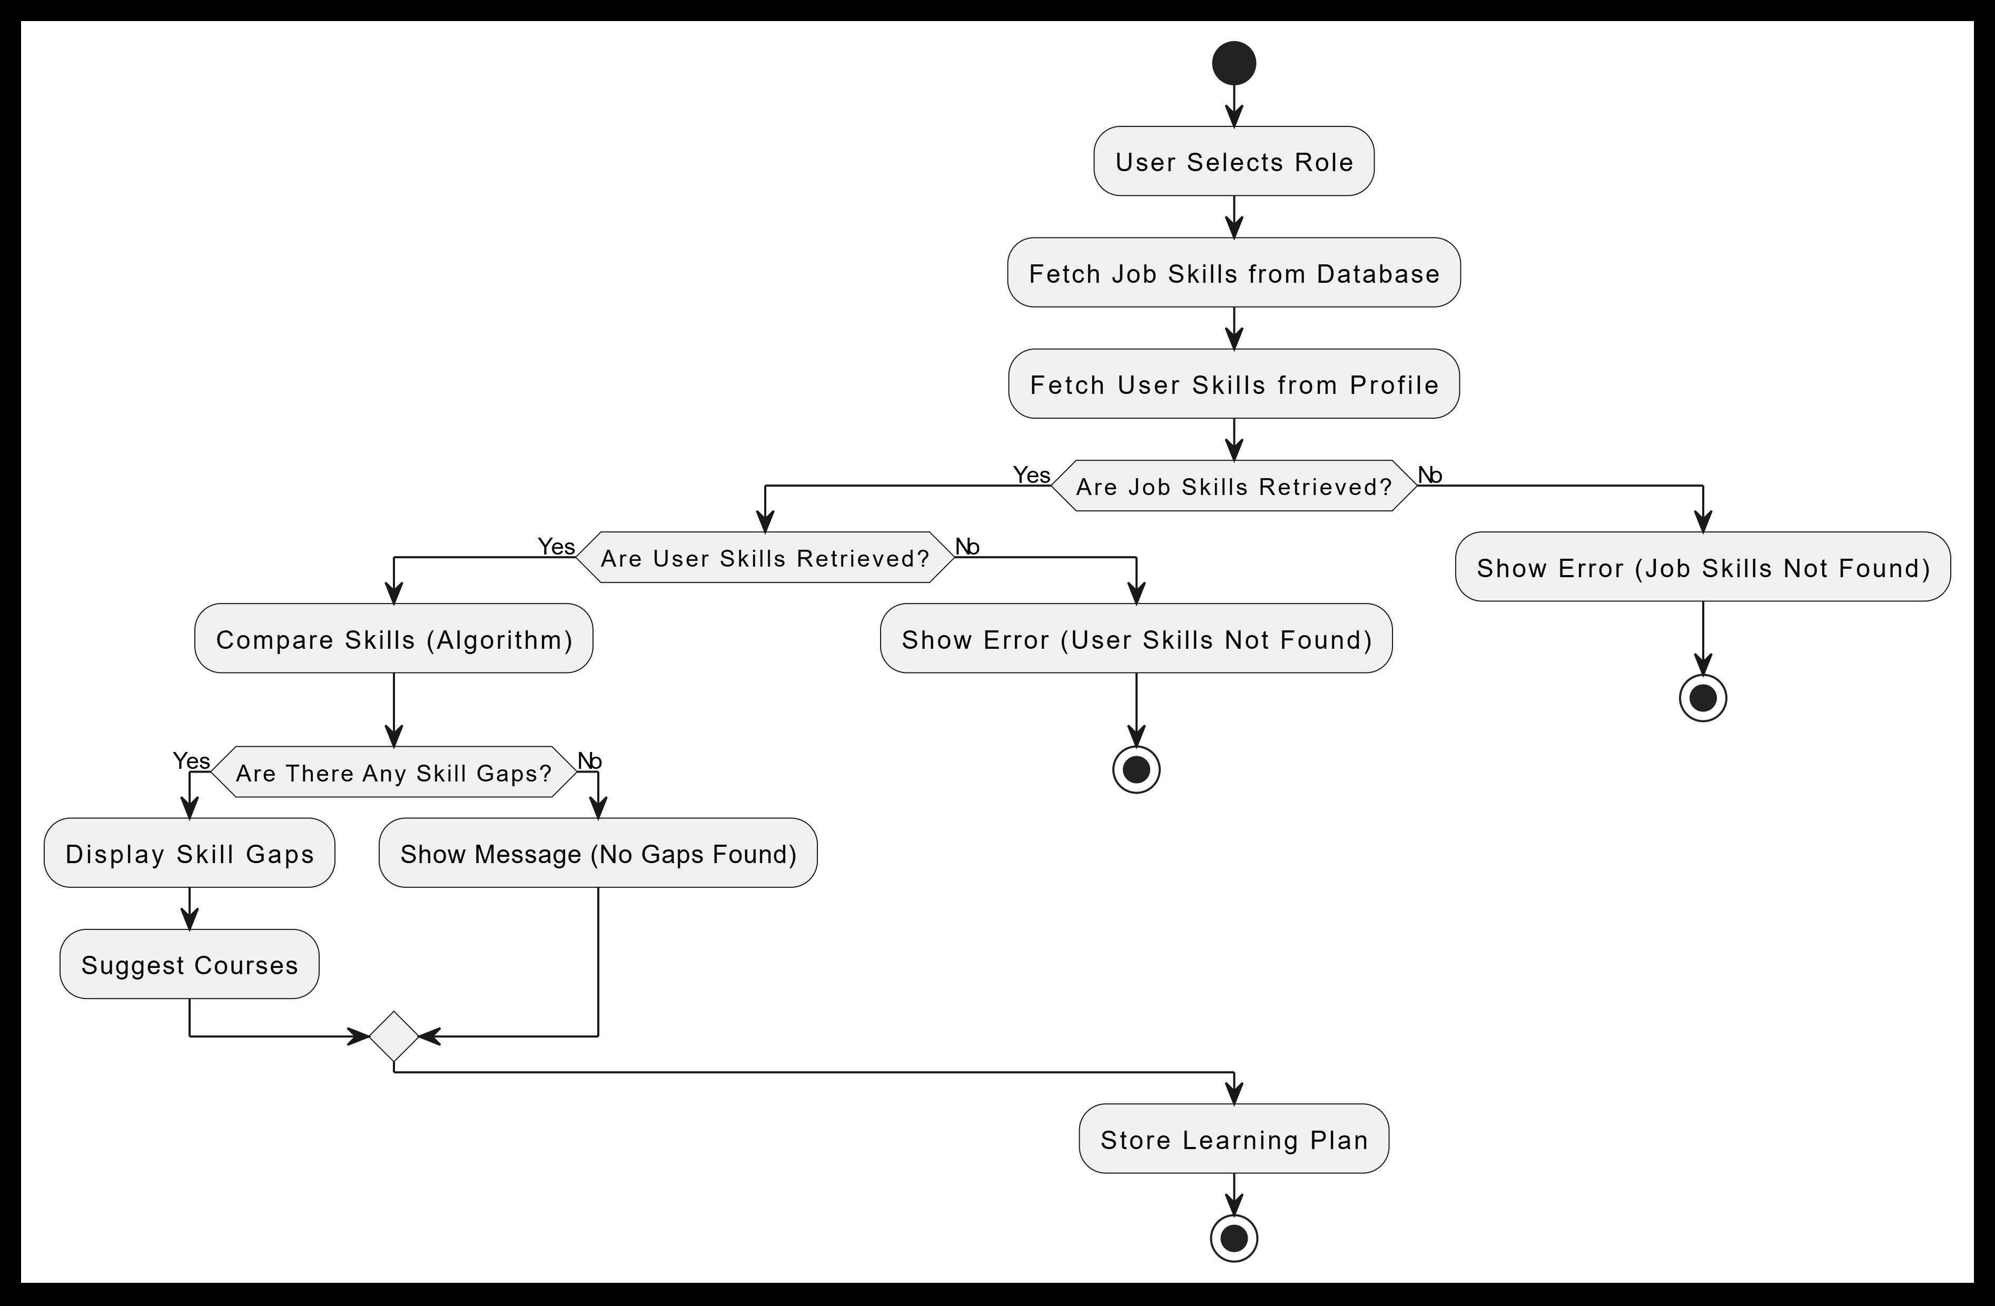
ACTIVITY DIAGRAM

Slide 15
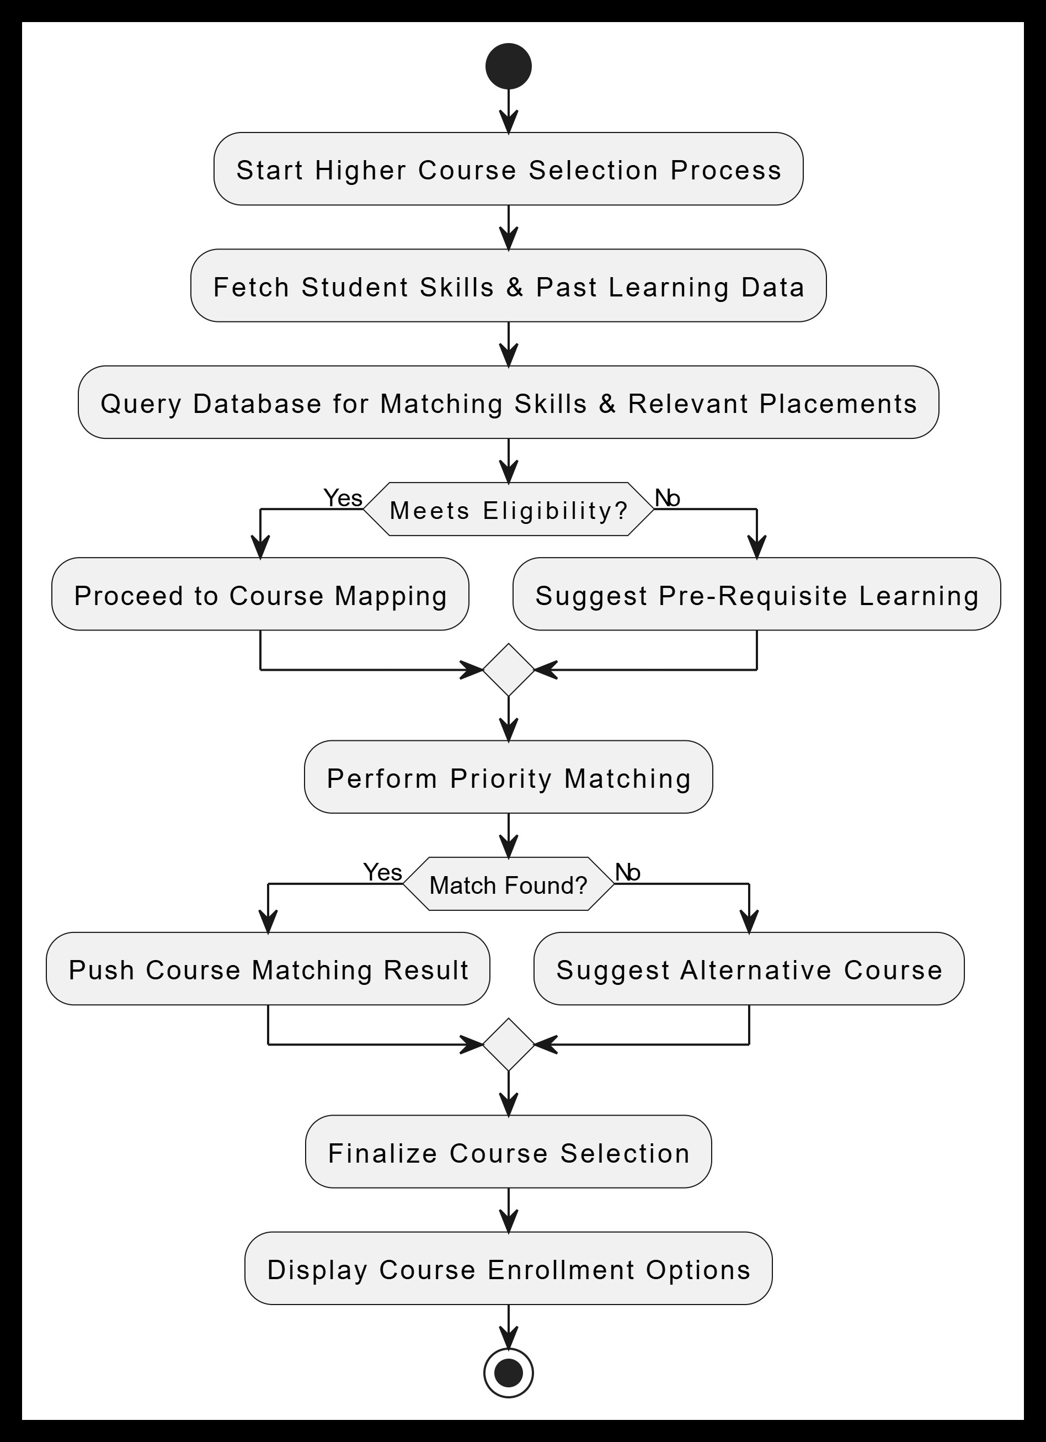
ACTIVITY DIAGRAM

Slide 16
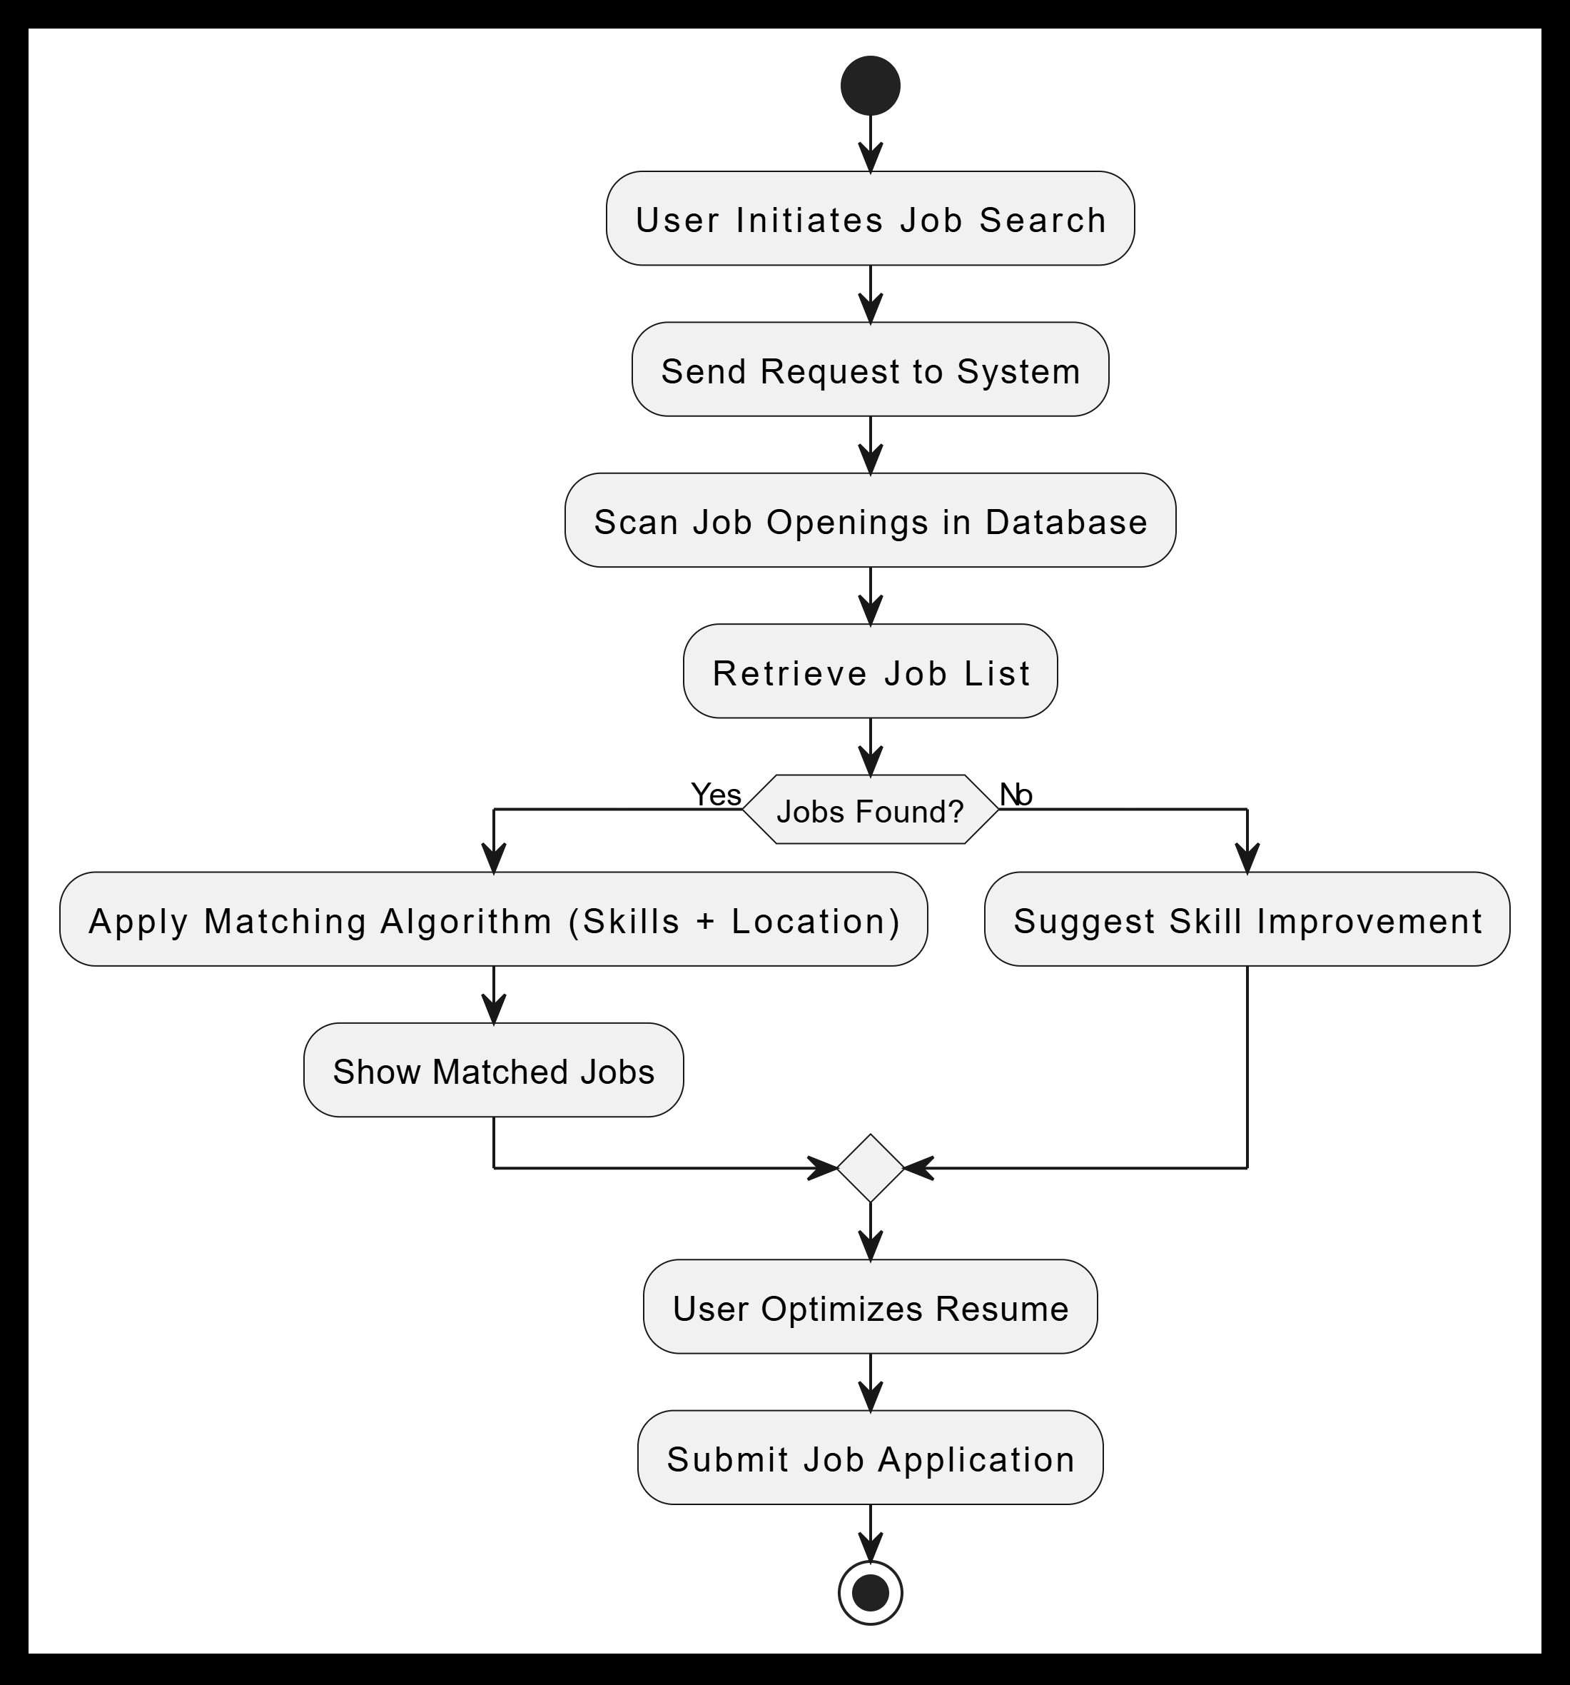
ACTIVITY DIAGRAM

Slide 17
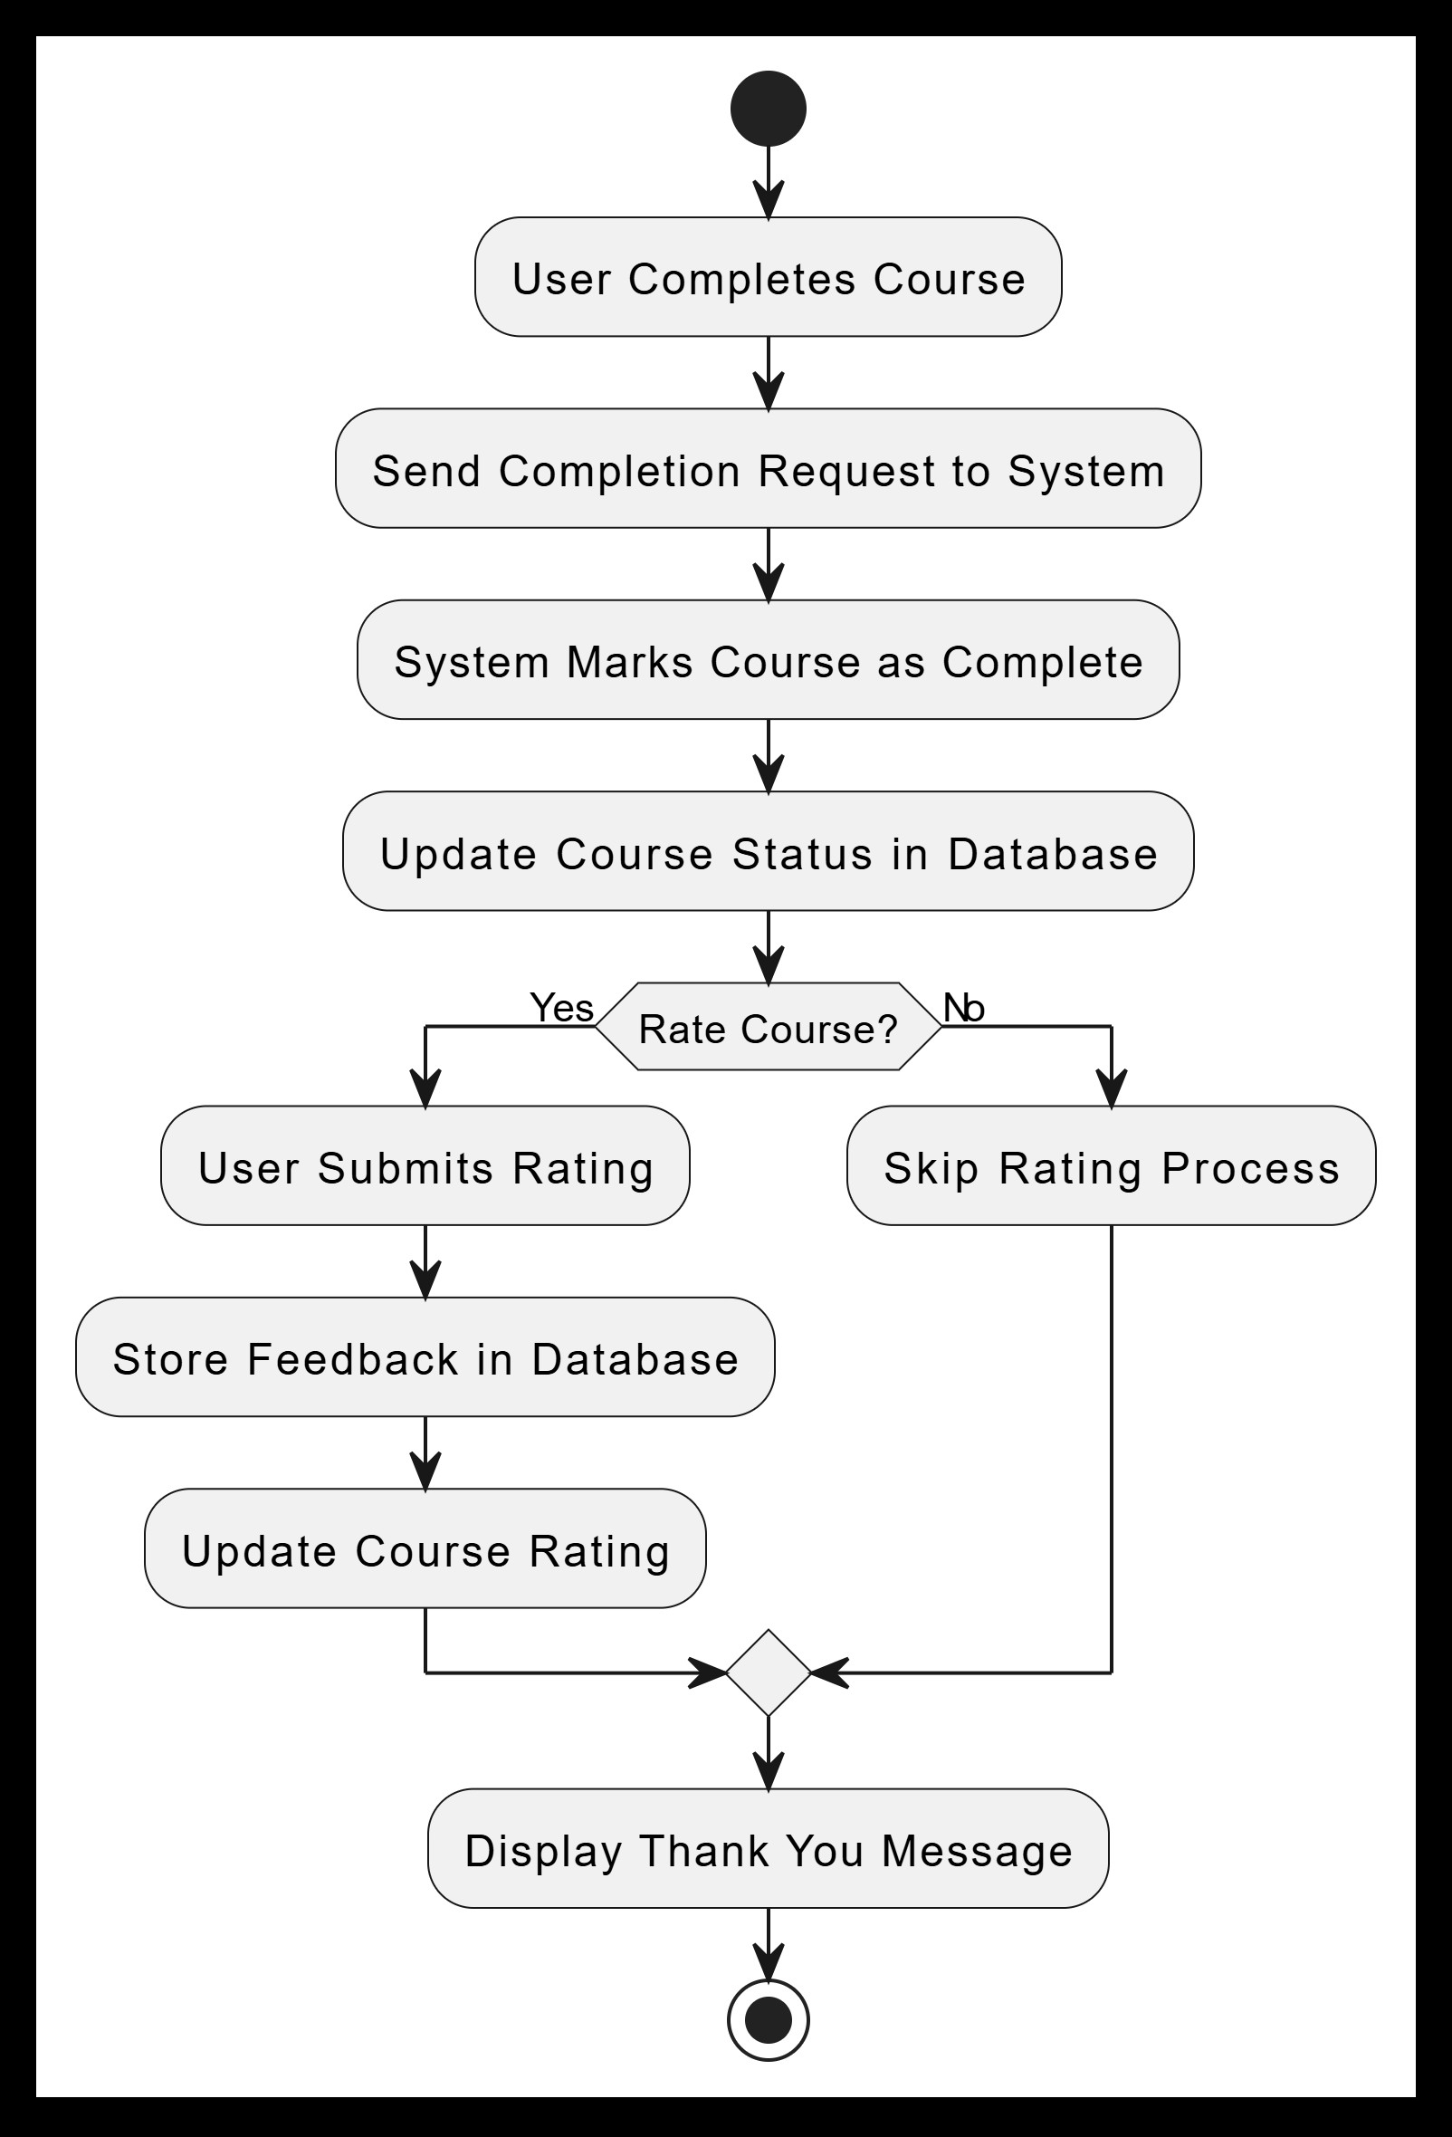
ACTIVITY DIAGRAM

Slide 18
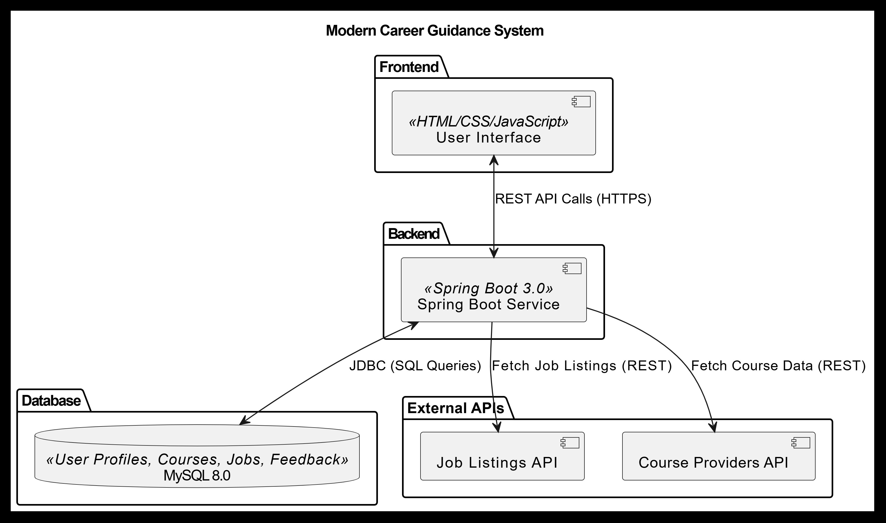
COMPONENT DIAGRAM

Slide 19
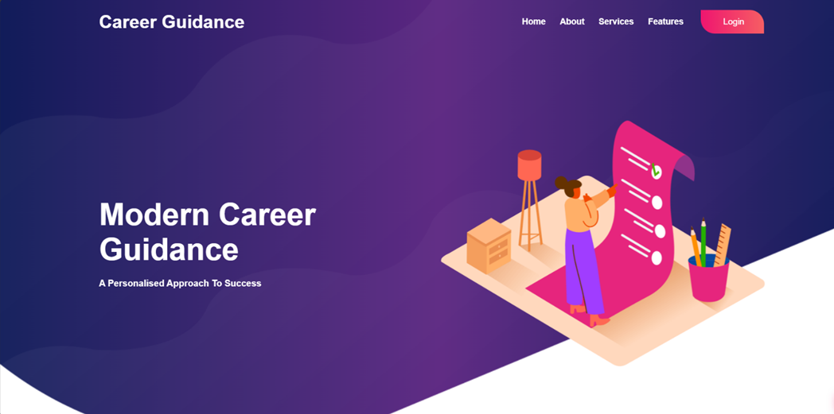
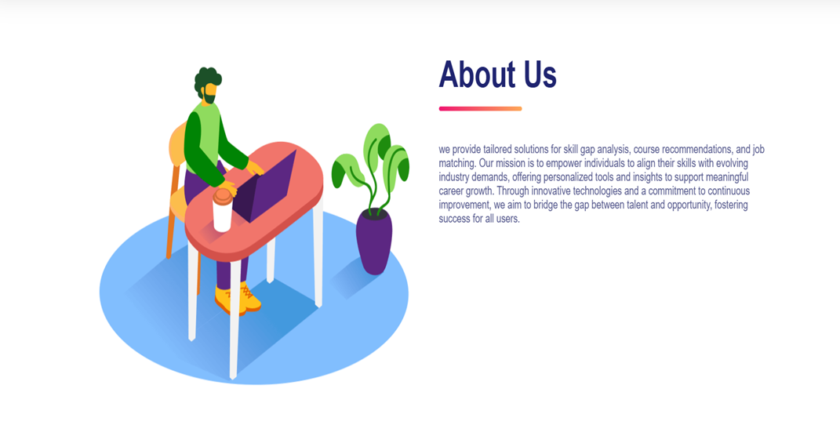
SCREENSHOTS

Slide 20
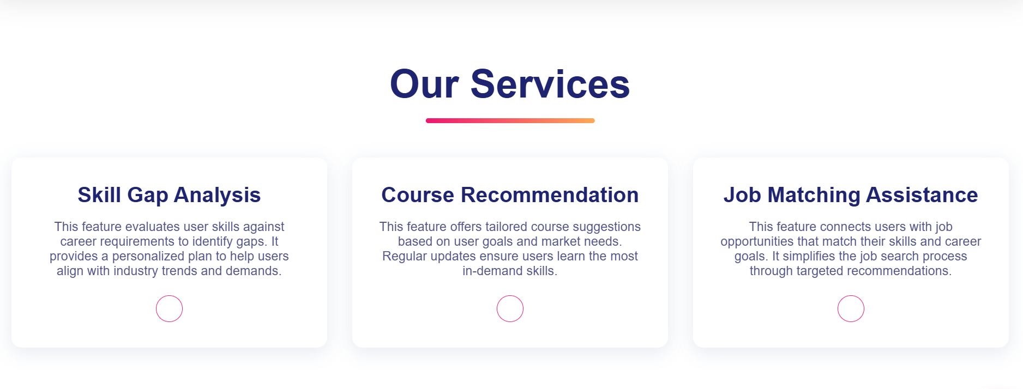
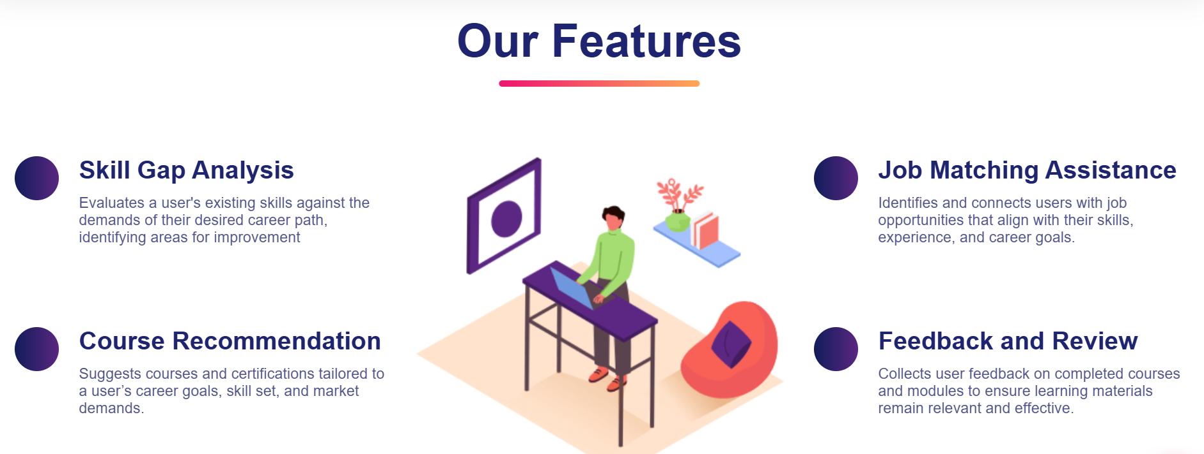
SCREENSHOTS

Slide 21
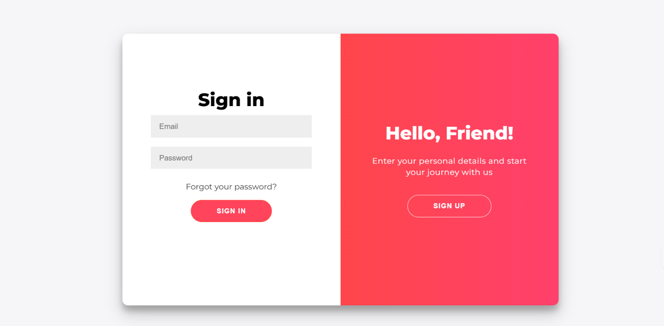
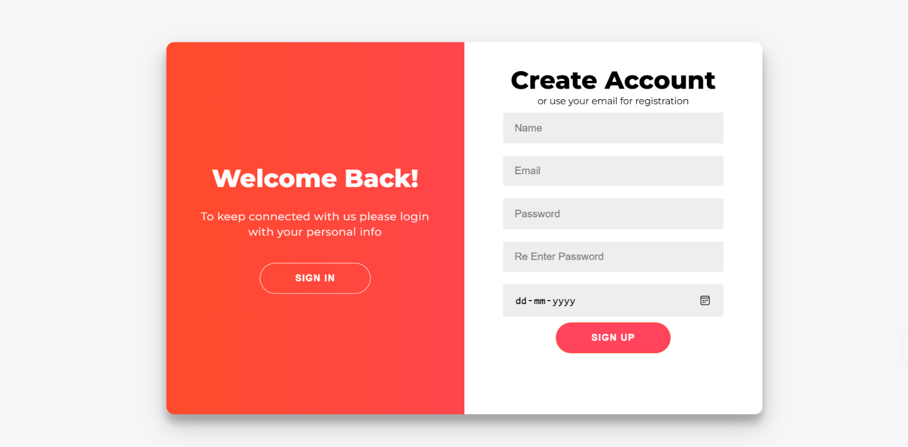
SCREENSHOTS

Slide 22
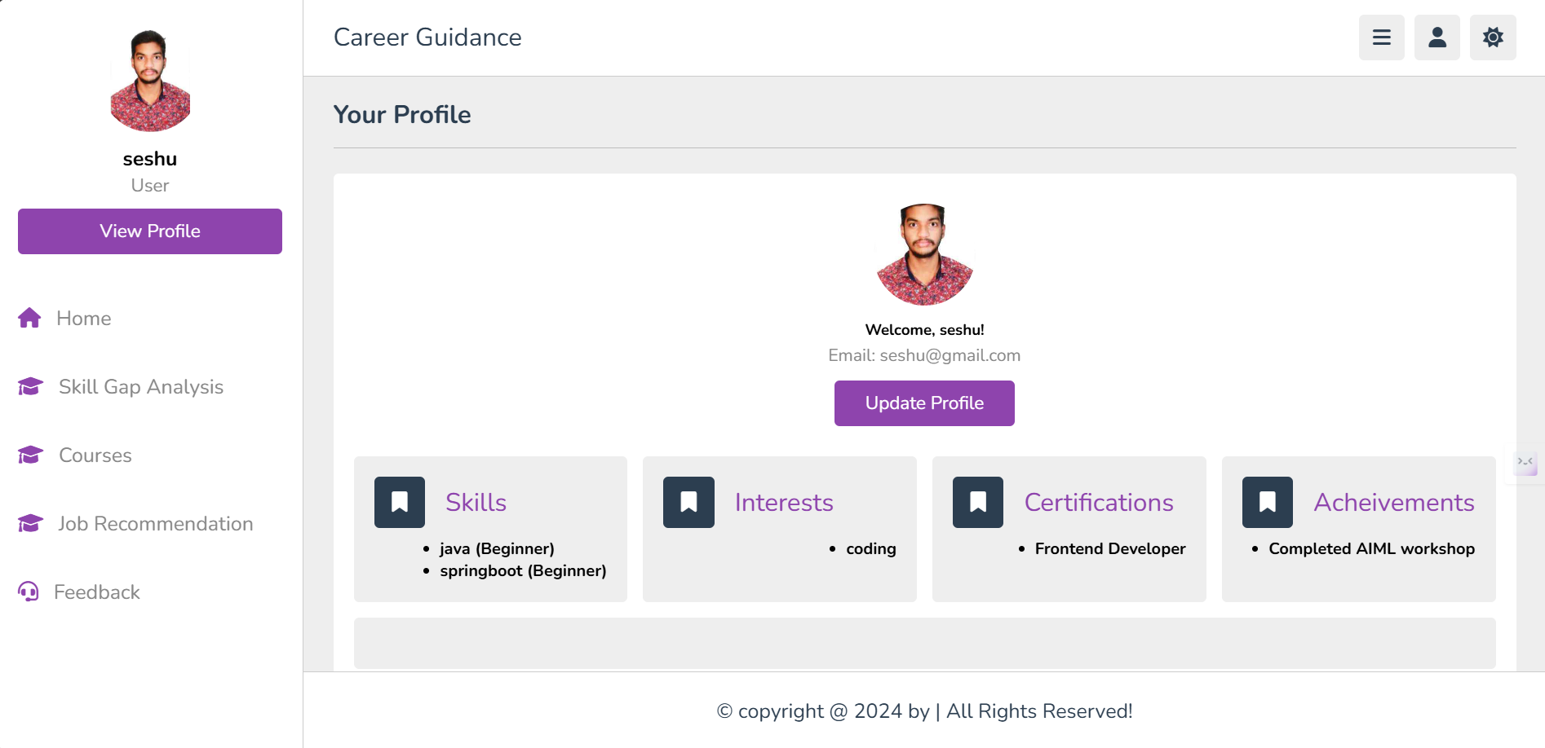
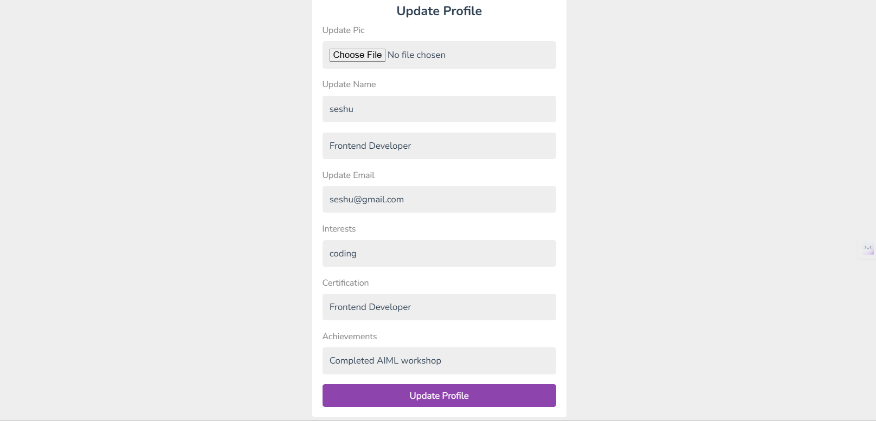
SCREENSHOTS

Slide 23
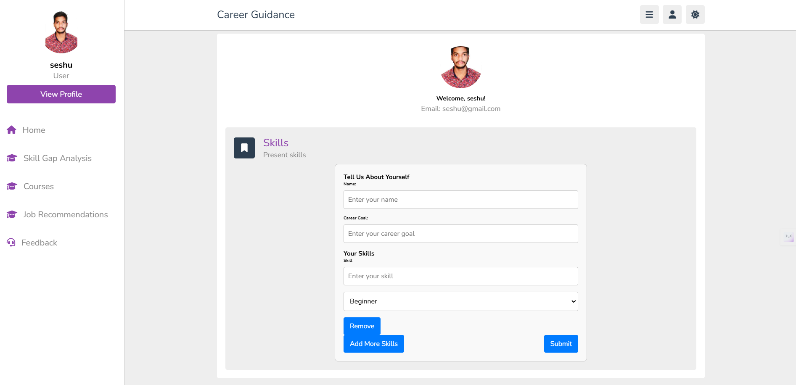
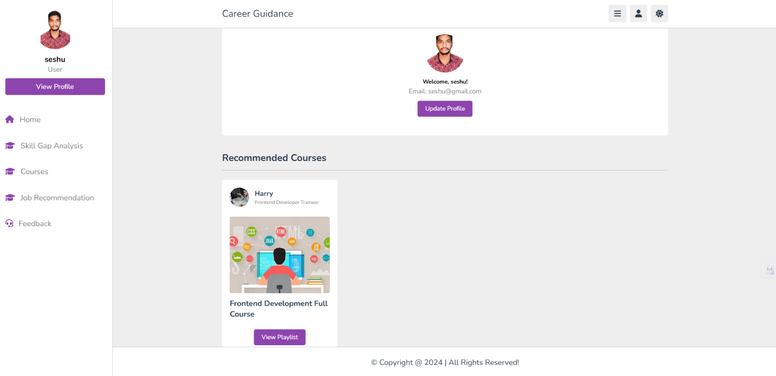
SCREENSHOTS

Slide 24
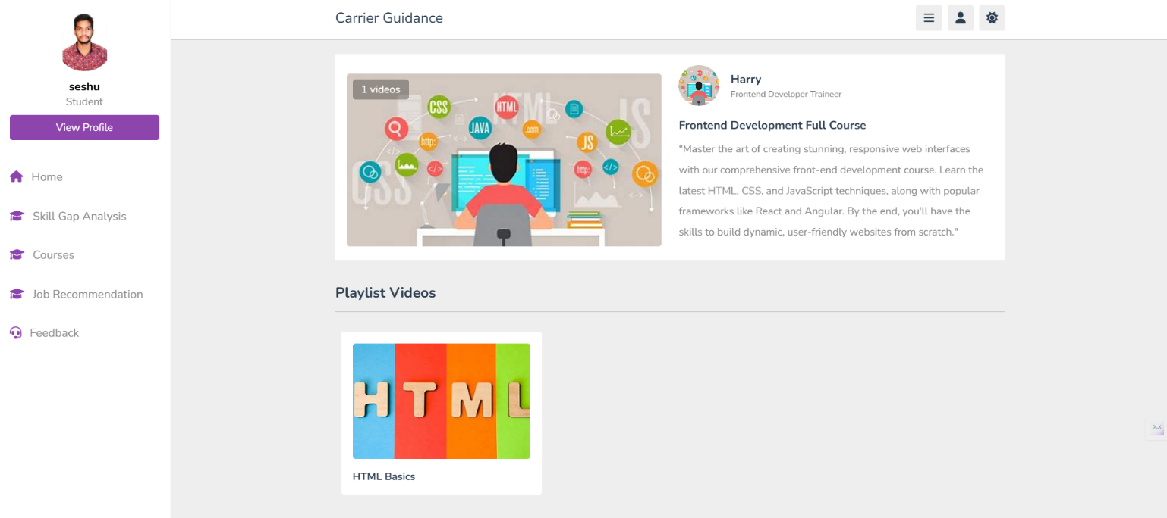
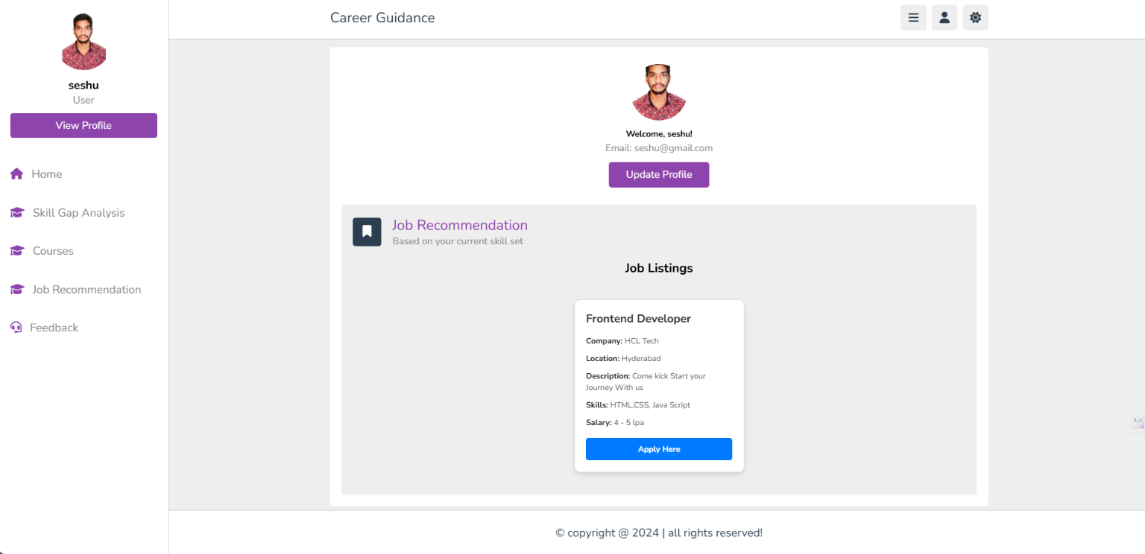
SCREENSHOTS

Slide 25
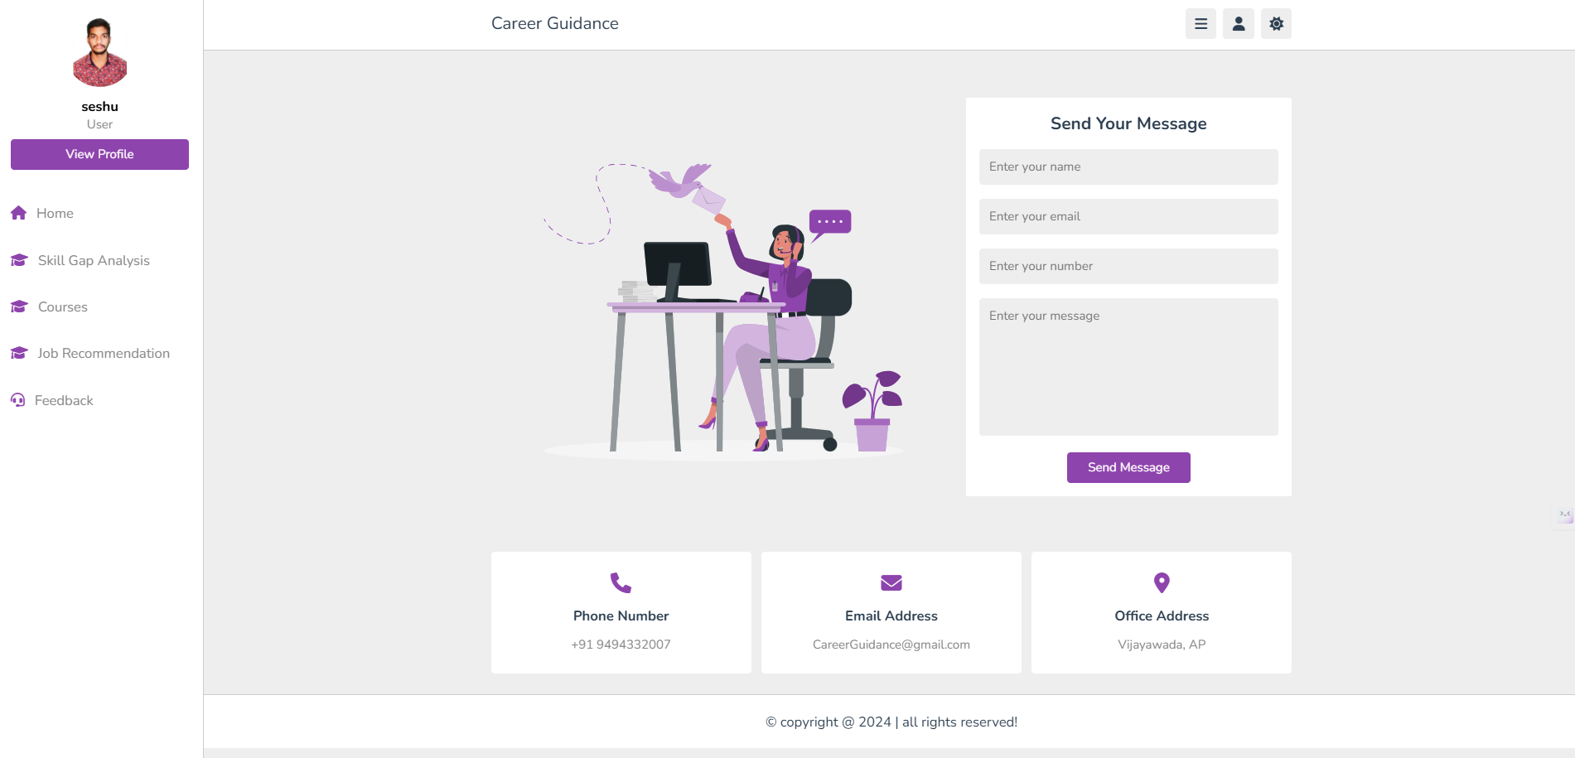
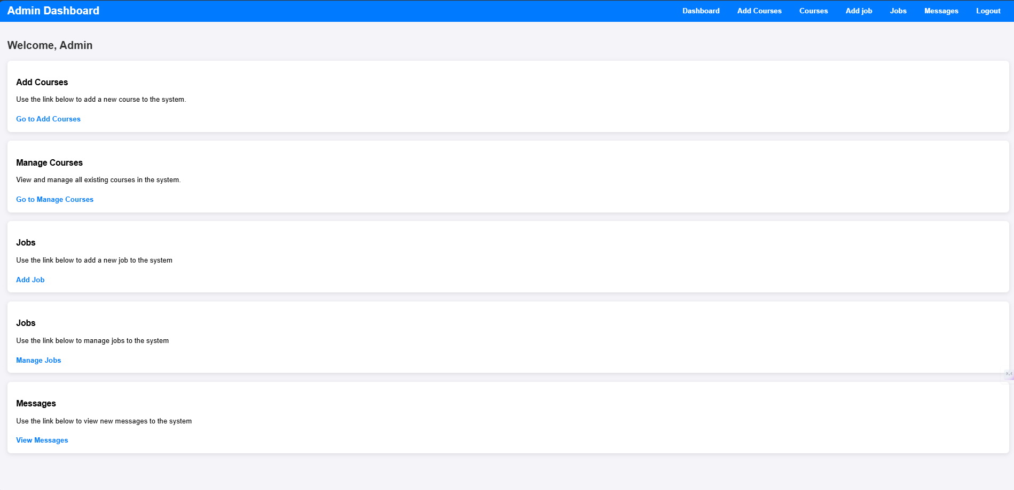
SCREENSHOTS

Slide 26
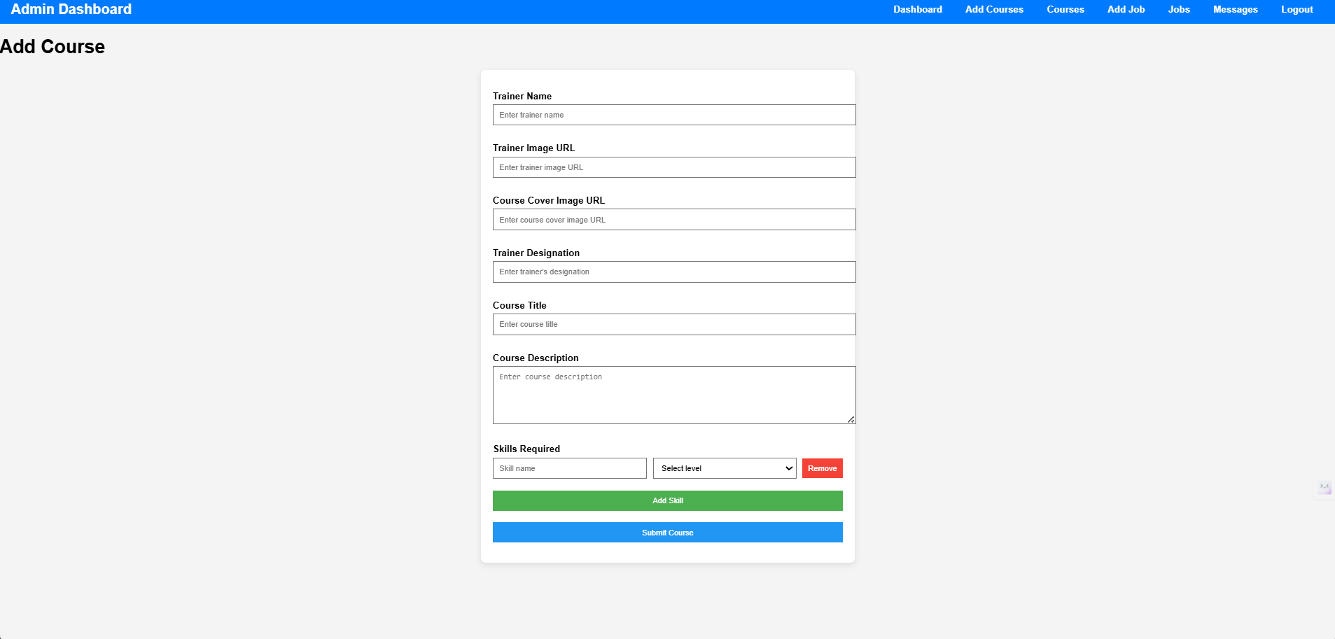
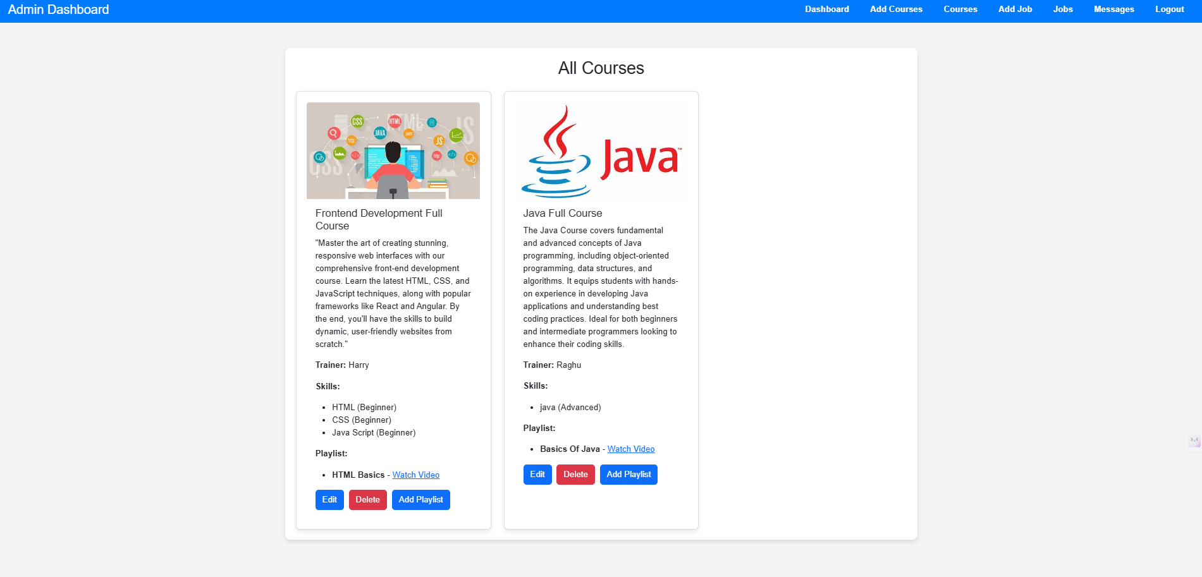
SCREENSHOTS

Slide 27
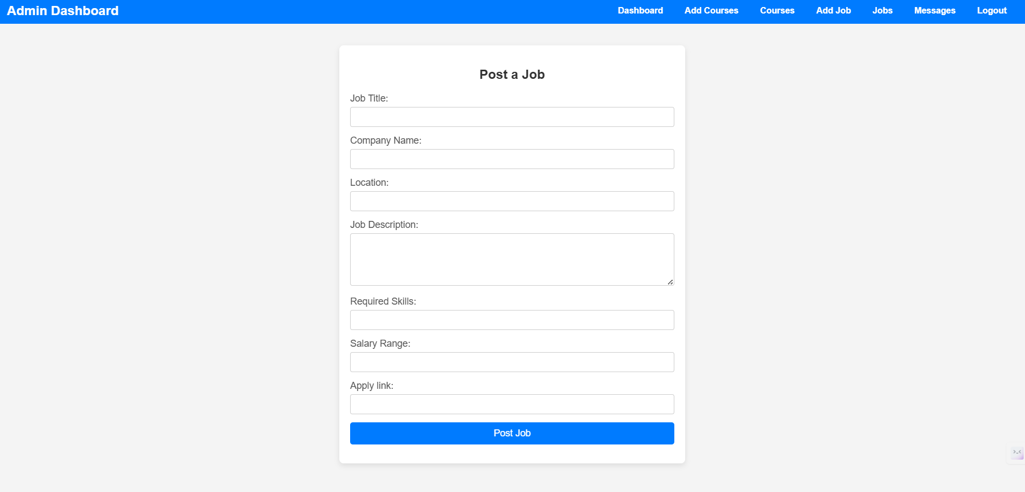
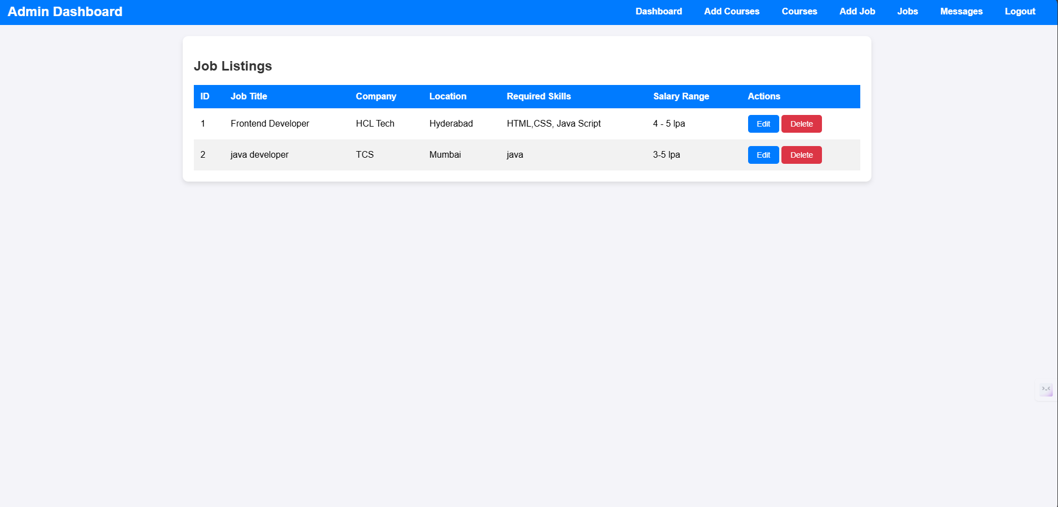
SCREENSHOTS

Slide 28
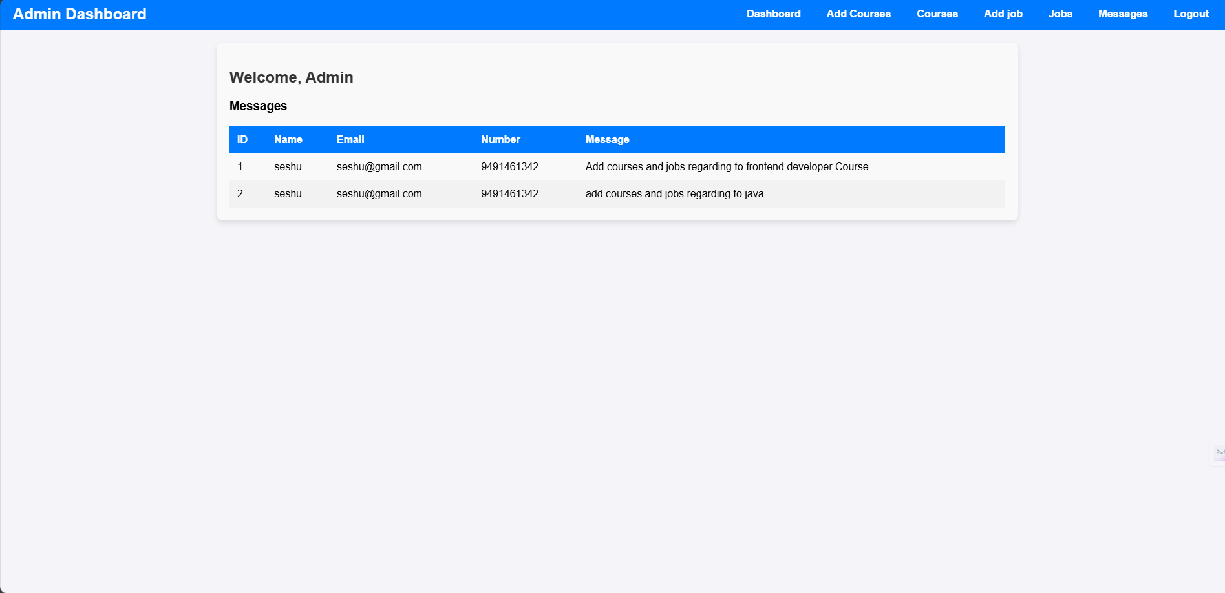
SCREENSHOTS

Slide 29
KEY MILESTONES
1.Project Planning:
Define objectives, requirements, and scope &Create detailed system architecture and design.
2.System Design:
Develop the data flow and module designs(Skill Gap Analysis,Course Recommendations,Job Matching etc.)
Finalize technology Stack(Java Full Stack, MySQL,etc).
3.Development:
Frontend: Build responsive UI(using HTML,CSS,JavaScript).
Backend:Implement core functionalities using java ,Spring Boot, MySQL).
4. Security Implementation:
Integrate user authentication and data encryption & Ensure secure storage and transmission of sensitive data.
5.Testing:
Conduct unit,integration,and performance testing.
6.Deployment:
Deploy the platform on a secure hosting environment also ensure scalability and stability in real world conditions.
7.Future Integration:
Plan for integration with external API’s(eg: job boards,learning platfroms).
Include support for AI-based recommendation enhancements.
19-04-2025
Department of CSE
29

Slide 30
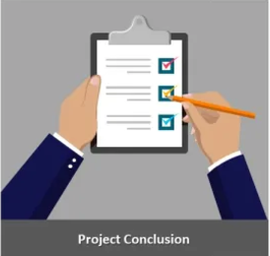
CONCLUSION
The Modern Career Guidance platform empowers users to take control of their career development by providing them with the insights, tools, and support needed to make informed decisions and achieve their aspirations. It fosters a proactive approach to career growth, ensuring that users are well-equipped to navigate the complexities of the dynamic job market and thrive in their chosen fields.
We are committed to ongoing research and development to enhance the capabilities of the Modern Career Guidance platform. We are actively exploring ways to integrate emerging technologies and incorporate user feedback to ensure that the platform remains a valuable resource for career advancement. We look forward to seeing how the Modern Career Guidance platform will empower users and shape the future of career development.

